Slide 1
Secondary Electron Detection
CAMTECH 2011
Regi

Slide 2
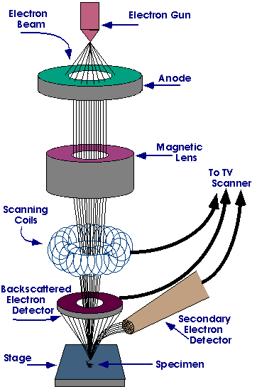
INTRO
High energy e⁻ beam scans sample surface (Raster - line by line).
Provides information about surface and near-surface atoms – topography and chemical composition.
Stereoscopic images (3D perspective)

Slide 3
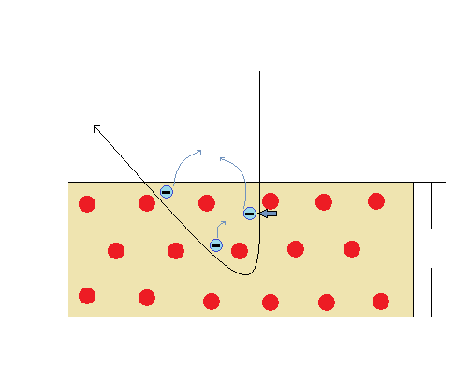
BEAM-SAMPLE INTERACTIONS
Incident beam
BSE
Emissions of SE
Electrostatic force
10nm
Constituent atoms

Slide 4
BEAM-SAMPLE INTERACTIONS
Backscattered Electrons (BSE) increase in reflectivity with growth in atomic number
Secondary electrons (SE) predominantly produced by the interactions between highly energetic beam electrons and weakly bonded.
Only SE produced within a depth of 10 nm can escape the sample
Specimen | Origin of e⁻
Metal | Conduction band
Insulator/Semiconductor | Valence band

Slide 5
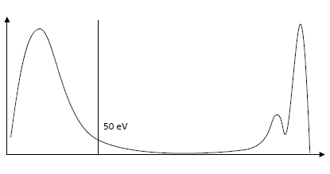
Secondary Electrons
Energy below 50 eV
Electron Emission Yield
The bigger the yield the bigger the signal intensity
- varies from material to material
- increases with e⁻-beam incident angle
SE
BSE
Relative count of emitted e⁻
1 10 100 1k 10k 20k
Energy of e⁻ emitted from specimen (log eV)

Slide 6
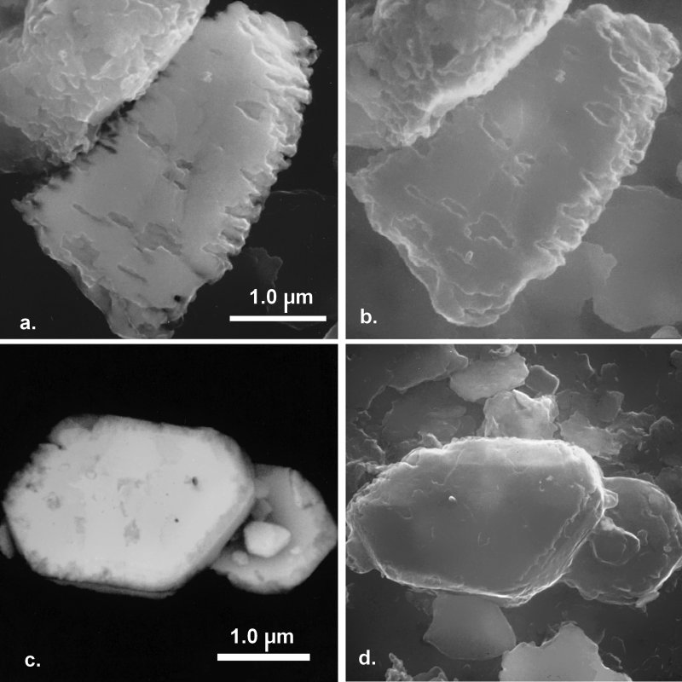
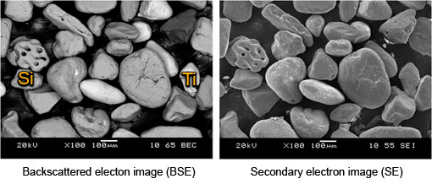
SE Images
Carry information about topography and defects adjacent to surface (depth) – 10 nm
BSE
SE

Slide 7
SE Detection
Distinguished SE1, SE2 and SE3
SE1: emitted from the e⁻-beam
irradiation point
SE2: emitted along with the
springing-out process of BSE
SE3: due to BSE collisions with
Parts other than the specimen

Slide 8
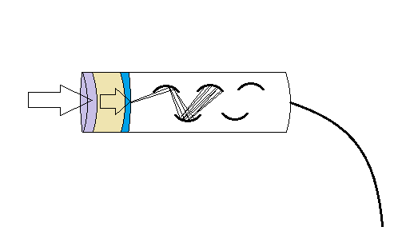
SE Detection
Everhart and Thornley Detector: designed in 1960 to collect and amplify the signal provenient from SE
Dynode
Collecting electrode
Scintillator
SE
Light guide
Photoelectric conversion face

Slide 9
Thanks!

